Slide 1


-Final FinTech Project Presentation-
Digital Wallet Integration System
Aggeliki Vogiatzoglou
Anestis Dimou
Panagiotis Vavalos
Panagiotis Kavvadias

Slide 2
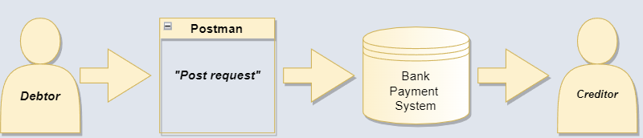
Scope
“The aim of this project is to add a digital e-wallet payment method to an existing simplified system of payments ”
Payments by Card
E-Wallet payments

Slide 3

Team Objectives
Delivered fully functional system
Handle all potential errors
Avoid to affect existing system
Perform all necessary validations

Slide 4
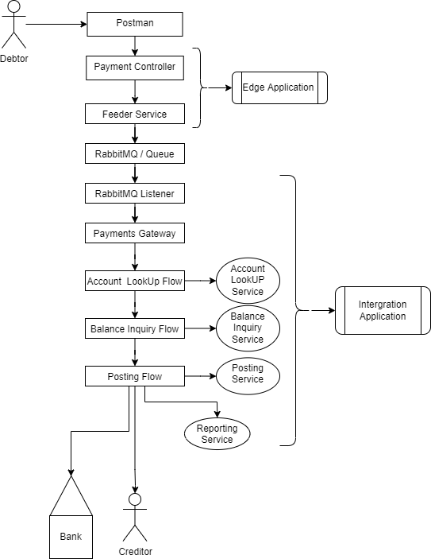
Current System Flow
Debtor sends a post request with payload.
Payment controller receives the post request.
Feeder Service pushes the payload to the queue.
RabbitMQ listener consumes the payload.
Payments Gateway initiates the payment process.
Account LookUp Flow validates Debtor & Creditor.
Balance Inquiry Flow checks the transaction financially.
Posting Flow performs the transaction.
Creditor receives the payment amount.

Slide 5
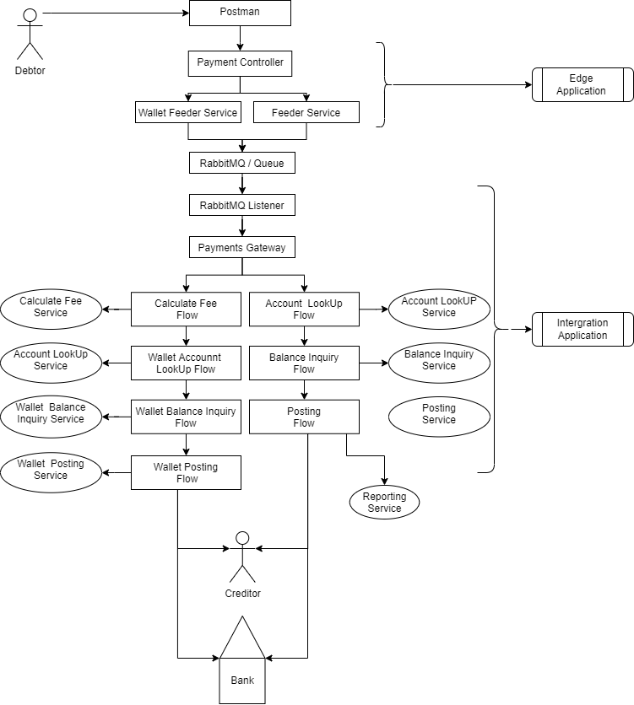
Upgraded e-Wallet System Flow
Debtor sends a post request with payload.
Payment controller receives the post request.
Wallet Feeder Service pushes the payload to the queue.
RabbitMQ listener consumes the payload.
Payments Gateway initiates the payment process.
Calculate Fee Flow calculates fee amount.
Wallet Account LookUp Flow validates Debtor & Creditor.
Wallet Balance Inquiry Flow checks the transaction financially.
Wallet Posting Flow performs the transaction.
Creditor receives the e-Wallet payment amount.

Slide 6

System Security
Basic Authentication method was used to secure the system
from unauthorized access.
Authentication succeeded by sending in the Post request’s Header the credentials
of the user.
If the user exists and have the privileges to access the page, system authenticates
them.
If not, the system rejects the request.
Notes:
pBI

Slide 7
System in Action
Notes:
Μετά από αυτό μπορούμε να πούμε το κομμάτι «what was and was not accomplished»

Slide 8


Power BI - Sales Financial Dashboard
Create an interactive dashboard report for Monica Motors.
Analyze given financial data of 2013 & 2014, such as profits and sales.
Represent financial outcomes with Power BI visuals.

Slide 9
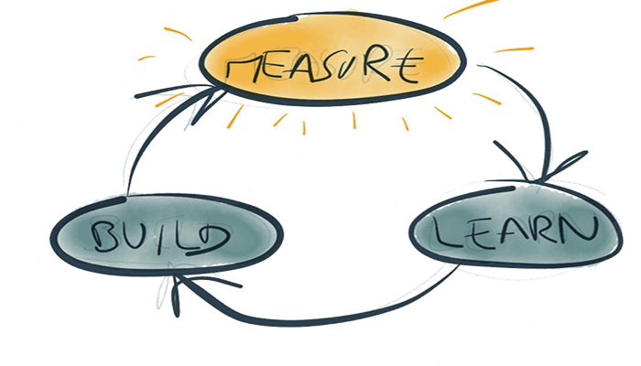
What We Learned
Spring Framework
Payment’s transaction procedure
Power BI tool
Teamwork
Communication
Collaboration

Slide 10

The END

